Slide 1

Planetary Habitat Systems Monitoring on a Mars Analog Mission HI-SEAS (Hawaii Space Exploration and Analog Simulation)
Engler, S.T.; Leung, H. (University of Calgary)
Binsted, K. (University of Hawaii)
Hunter, J. (Cornell University)
Abramov, O. (US Geology Department)
Wecking, W. (Hawaii Preparatory Academy)

Slide 2
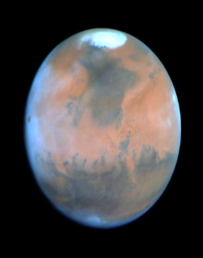
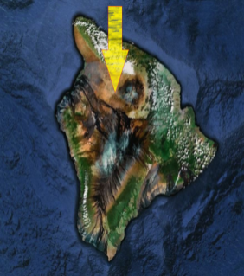
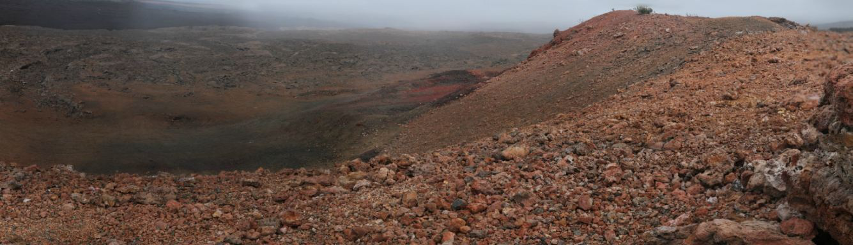
MARS ANALOG HABITAT LOCATION
Notes:
A new site for the HI-SEAS mission has been chosen to be on the slopes between Mona Loa and Mona Kea volcanoes on the big island of hawaii. As you can see from this picture the terrain here is very mars like. In fact, the curiousity rover on mars now, has confirmed that the rock formations seen in this area are the same chemical composition to those seen on the surface of mars. So this has turned out to be one of the most Mars-like areas on earth in terms of soil conditions. The habitat that we will be living in will be build in the bowl shaped depression on the left side of this picture.

Slide 3
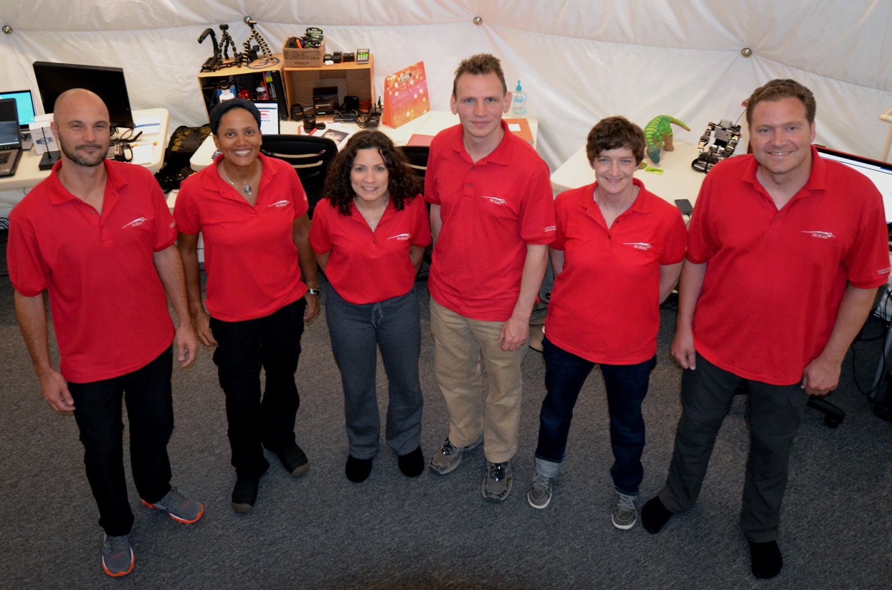
HI-SEAS Crew
‘Astronaut-Like’ Qualifications

Slide 4
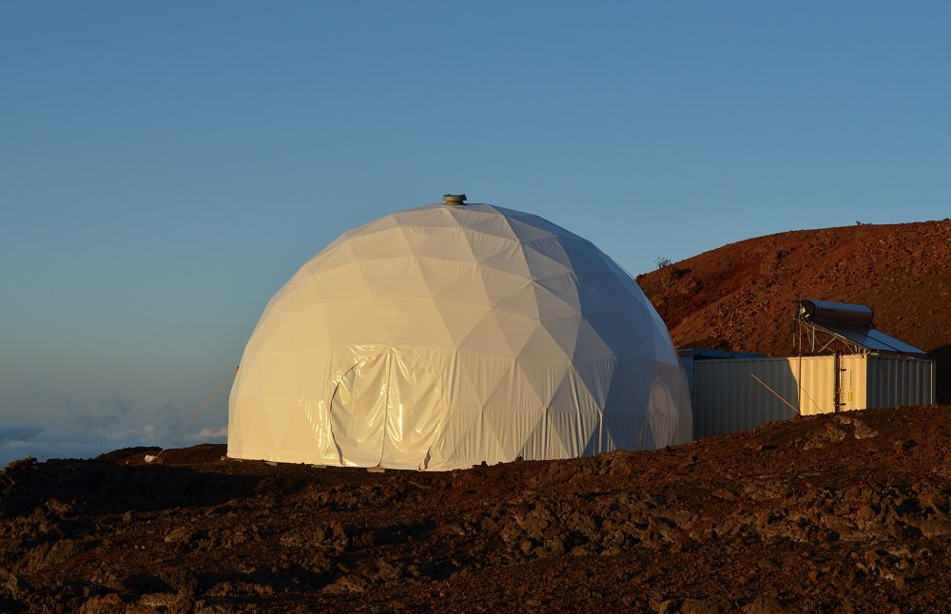
Habitat Design
Pacific Domes International
Blue Planet Foundation (Henk Rogers, Tetris Owner)
32-foot Diameter Dome
6 Bedrooms
Upstairs/Downstairs Bathroom
Lab
Airlock/Sea container
Living area
Dining Room
Kitchen
Washing Area

Slide 5
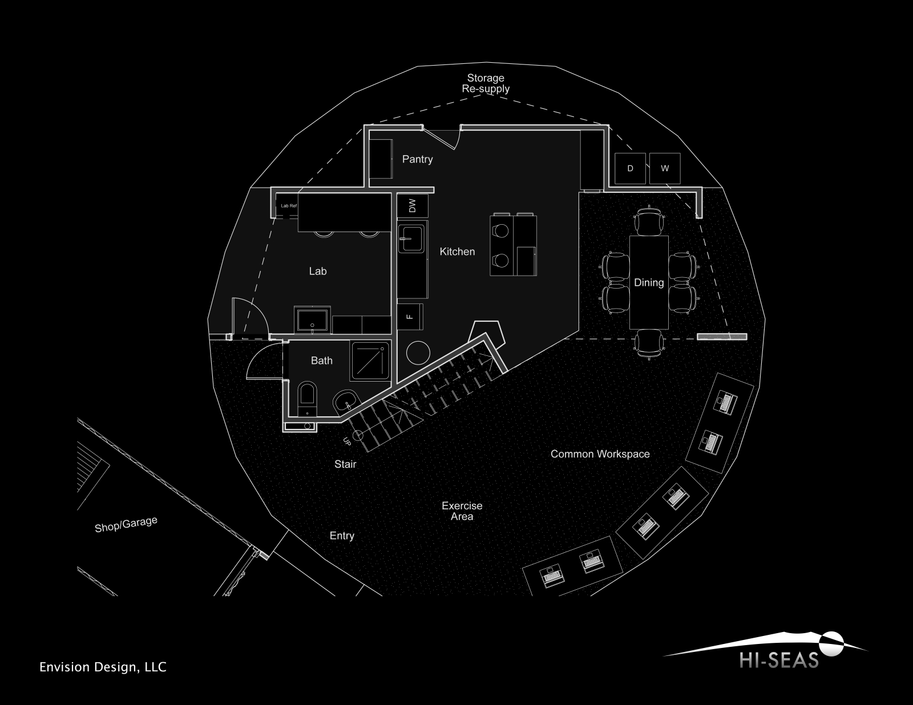
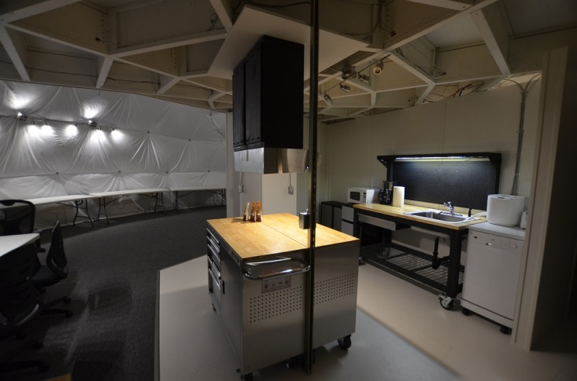
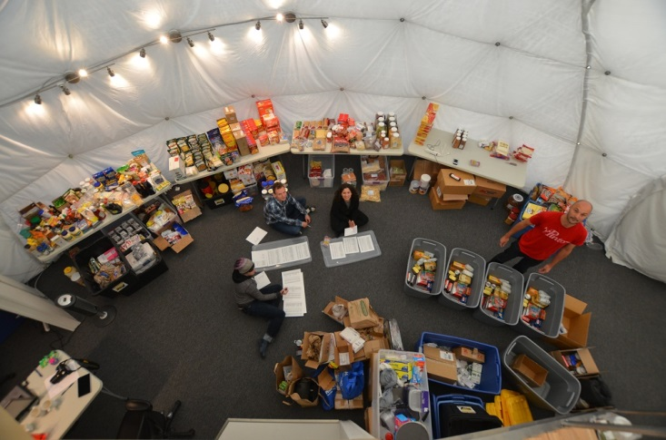
Main Floor Habitat

Slide 6
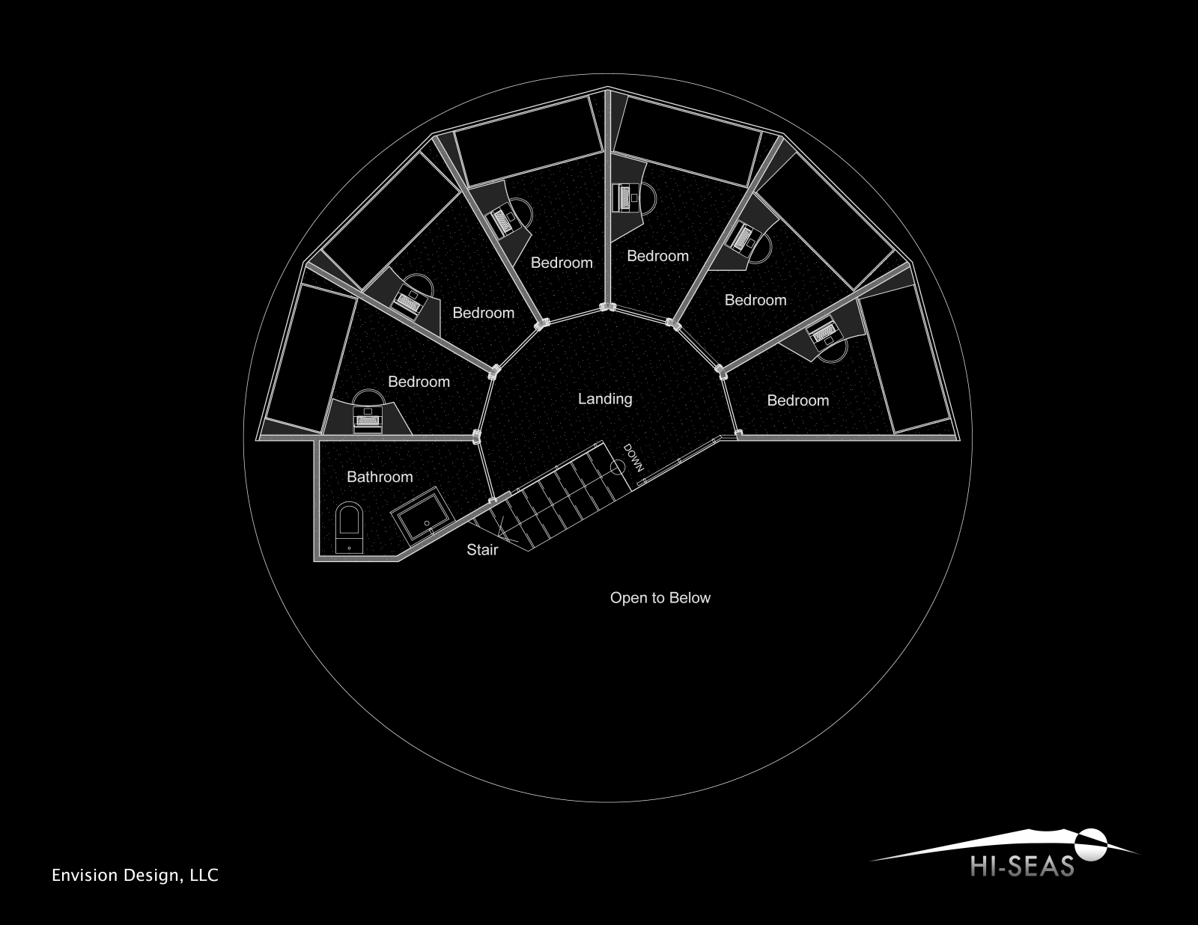
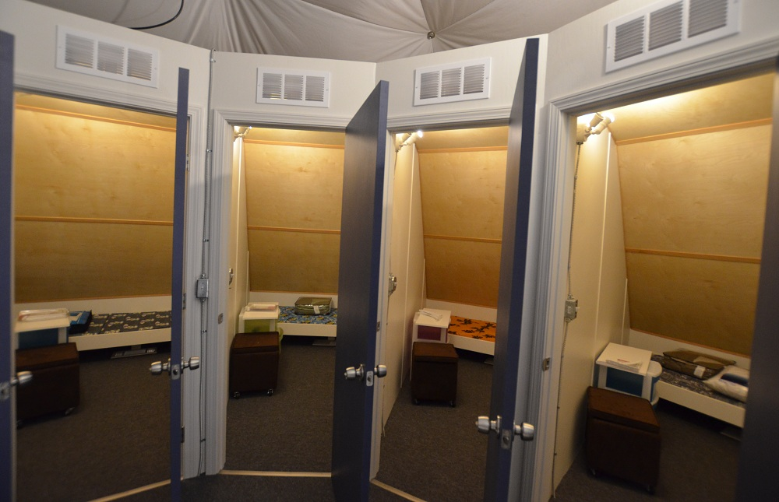
Second Floor Habitat

Slide 7
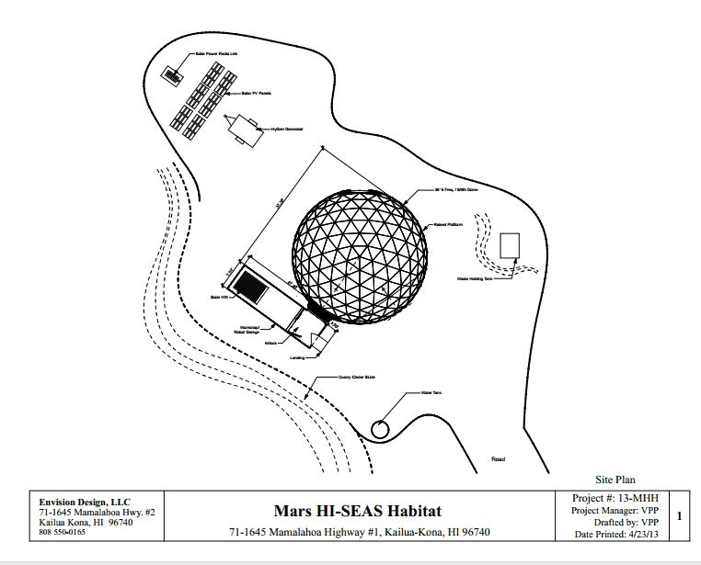
Site Layout
500 gallon water tank
250 gallon backup water tank
2 x 250 Gallon Septic Tank
250 gallon Grey water tank
Planetary Power Generator
Backup Generator
8 x Solar Panels
Telemetry and Communication Systems
100 gallon Solar Water Heater

Slide 8
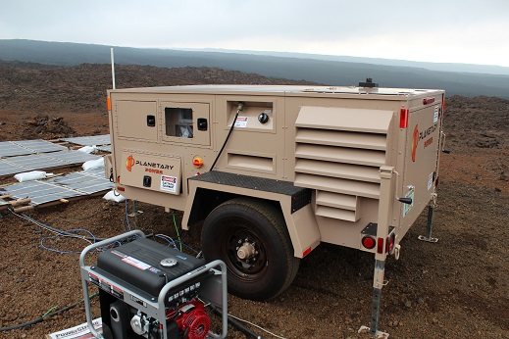
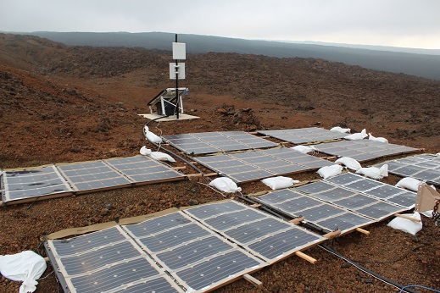
Power Systems
Planetary Power Hybrid Potential Voltage/Diesel Generator
150 A DC Disel Generator
120V/208V @ 60 Hz AC
Potential Voltage 480 VDC open circuit
20 Amp fuse
Panels max 3.3 kW @ 408 VDC
18.5% efficiency
Deployable stands, military grade equipment
Backup Generator (Honda gas powered Generator)

Slide 9
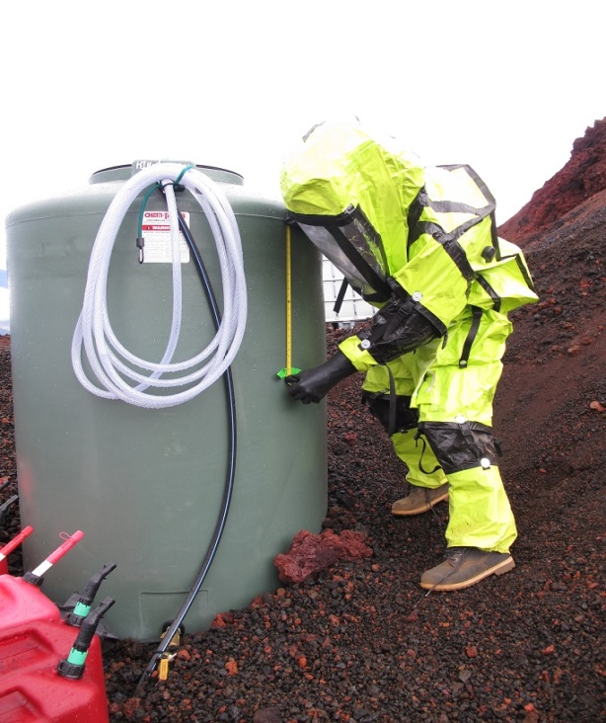
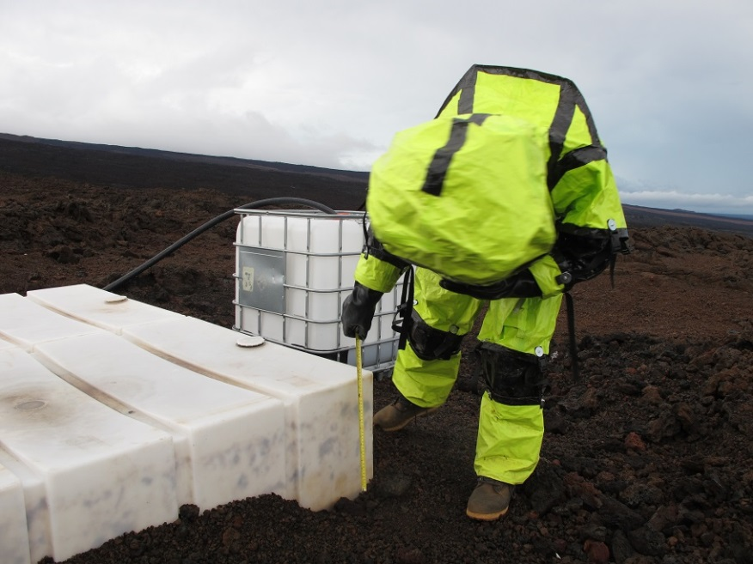
Water Systems
500 Gallon Main Tank
Jet Pump
Tank Level Sensor
Solar Hot water System
250 Gallon Backup Tank
2x 250 Gallon Septic Tank
Solahard Thermosiphon Solar Hot Water S
80 Gallon Tank
240 VAC backup heater
Manual measurements on Septic and Grey water tanks

Slide 10
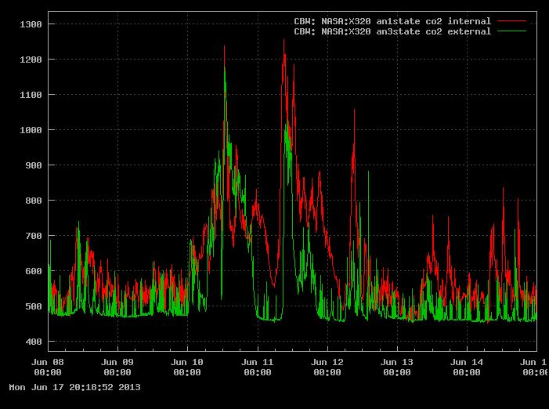
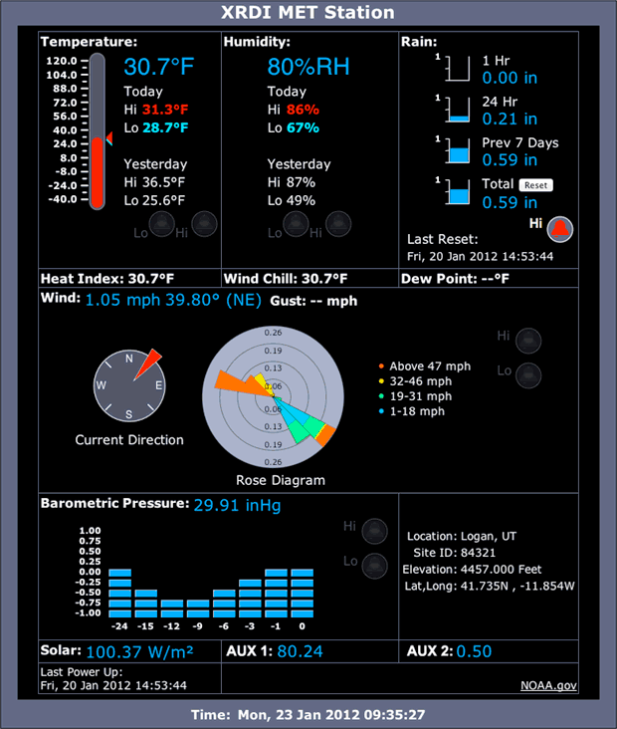
Sensor System
Water level sensor
CO2 /Humidity Sensors
3x Temperature Sensors
Power consumption Sensors
X320M Controllers updating data under 5 minute intervals
Weather Station
Wind Direction
Humidity
Solar Radiation
Rain Water

Slide 11
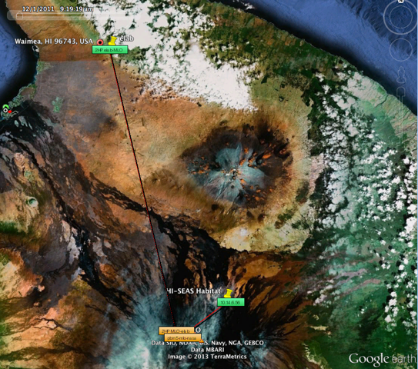
Telemetry
5.8 GHz 802.11 WAN
300 mb/s at 50 dB
Two 24 dB antennas splits signals and sends 60 km north to Hawaii Prepatory Academy.
One link is for sensor data to transmit over. The second is a FTP server for file exchanges
Internet link from site to telescope site on top of Mauna Kea.
20 Minute communication delay imposed on all external comms (except emergencies)

Slide 12
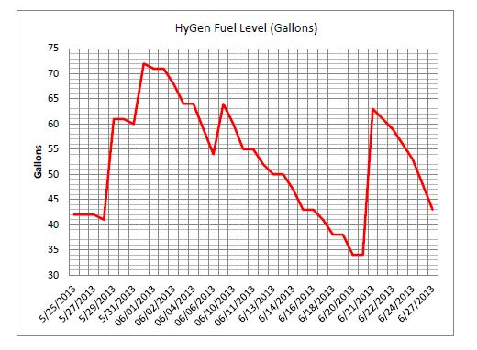
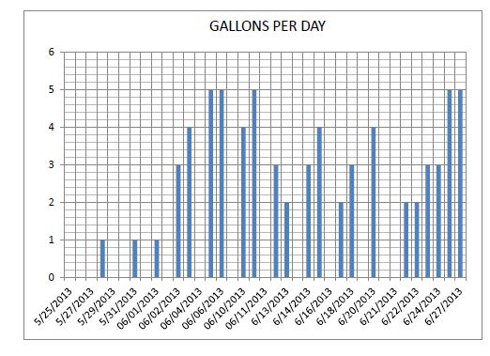
Generator Mission Results
Average of 3 gallons Diesel fuel per day

Slide 13
Septic Tank Mission Results
Average 6 days fill 500 Gallons

Slide 14
Grey Water Tank Mission Results
Only Laundry machine feeding into Grey Tank
Average of 50 Gallons/Week

Slide 15
Main Water Tank Mission Results
Average 60 Gallons per day (10 Gallons/Person)
Filled 3 times per week on average (280 Gallon Refill Trailor)

Slide 16
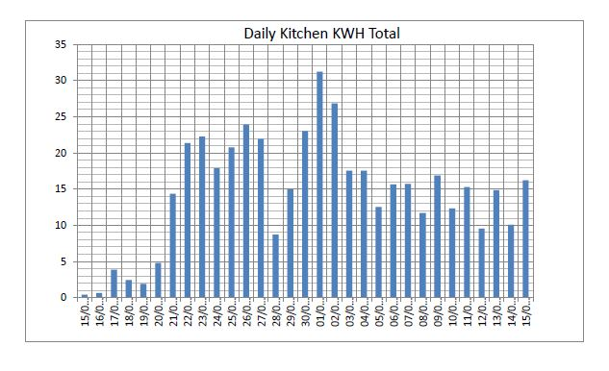
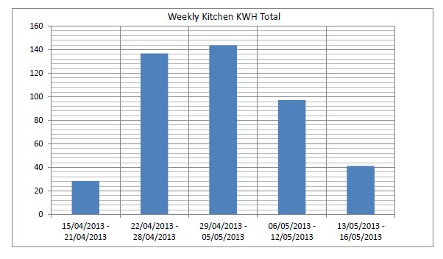
Power Usage Over Mission
Kitchen power usage main interest to study
Daily Average 15 kWh
Weekly Average 86 kWh
Moderate Difference Cooking/Non-Cooking Days

Slide 17
Grand Totals 120 Days
Total Power Usage:
10800 kWh ($1700 @ 16cent/kWh
Kitchen Power: 5760 kWh ($921 @ 16c/kWh)
Total Water Usage: 7800 Gallons (29,526 Liters)
Moderate Difference Cooking/Non-Cooking Days

Slide 18
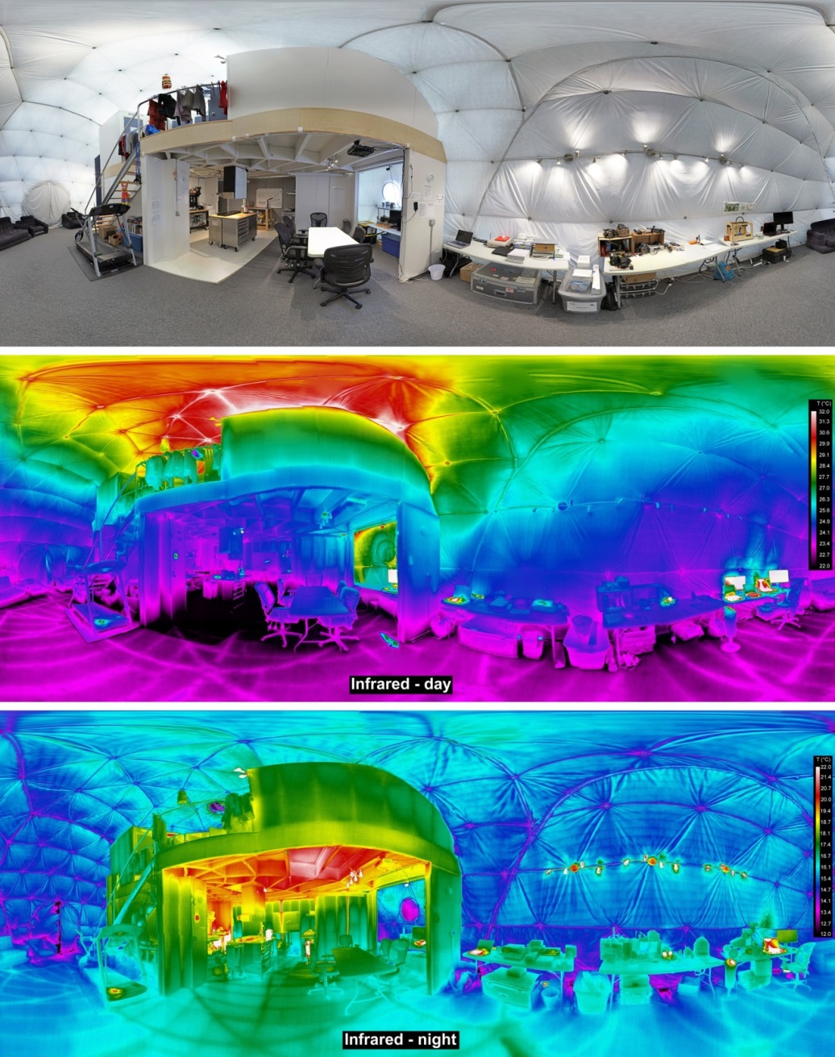
Habitat Thermal Properties

Slide 19
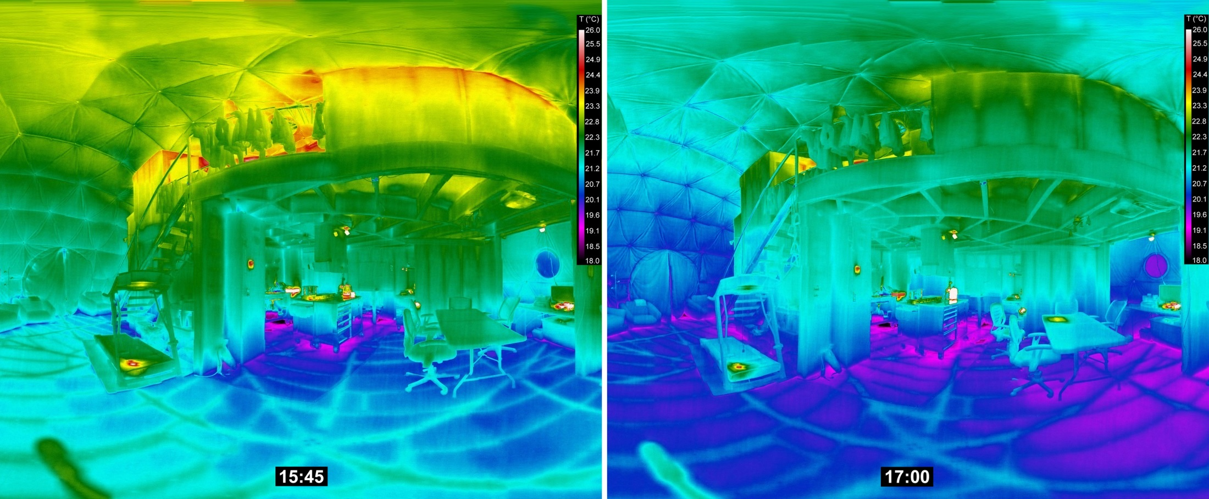
Habitat interior temperature changes – late afternoon

Slide 20
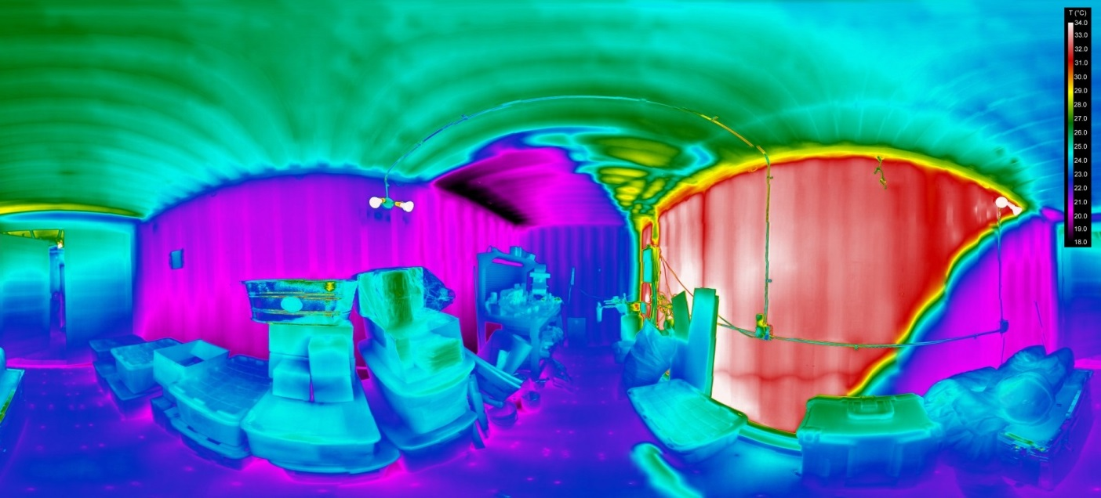
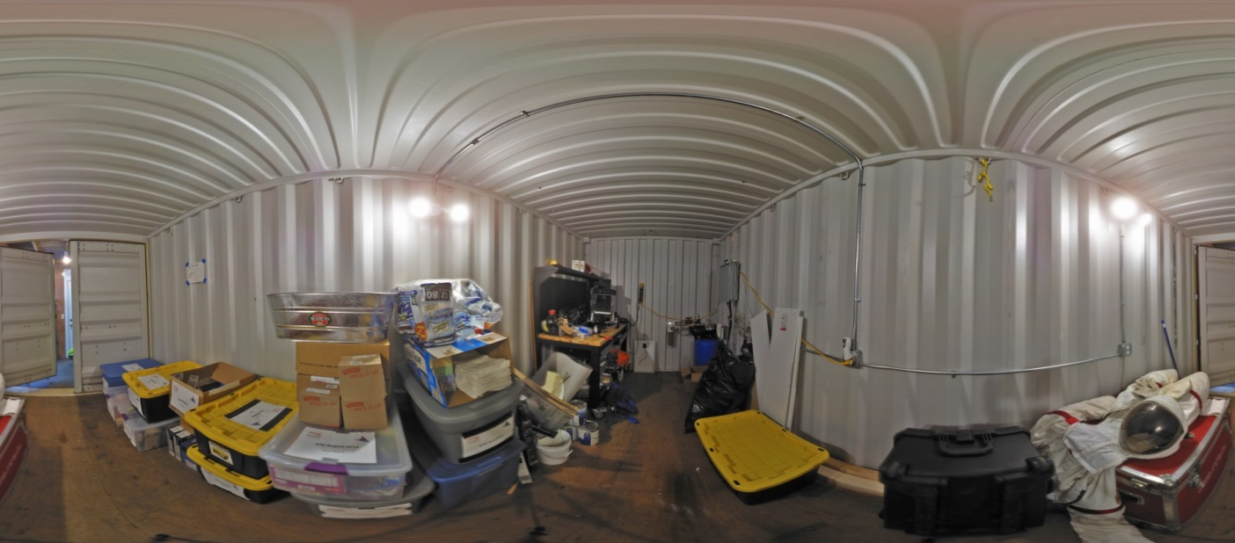
Habitat Thermal Properties
Shipping container, afternoon thermal panorama
Shipping container, visible-light panorama

Slide 21
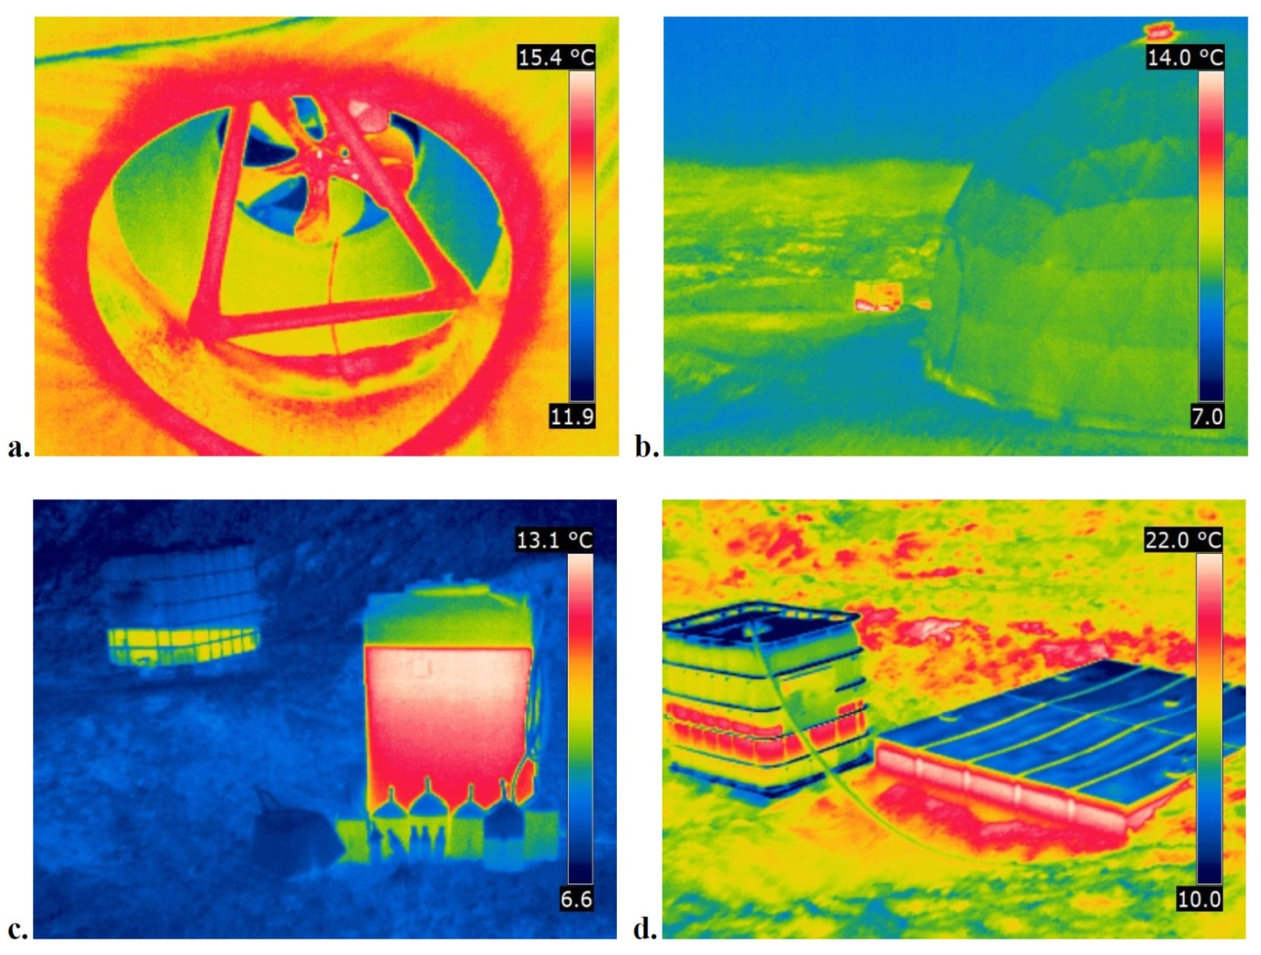
(a) Hab’s ceiling fan, night. (b) Hab exterior and greywater tank (background), night. (c) Primary (right) and backup (left) water tanks, night. (d) Greywater tank (left) and septic tank (right), late afternoon.

Slide 22
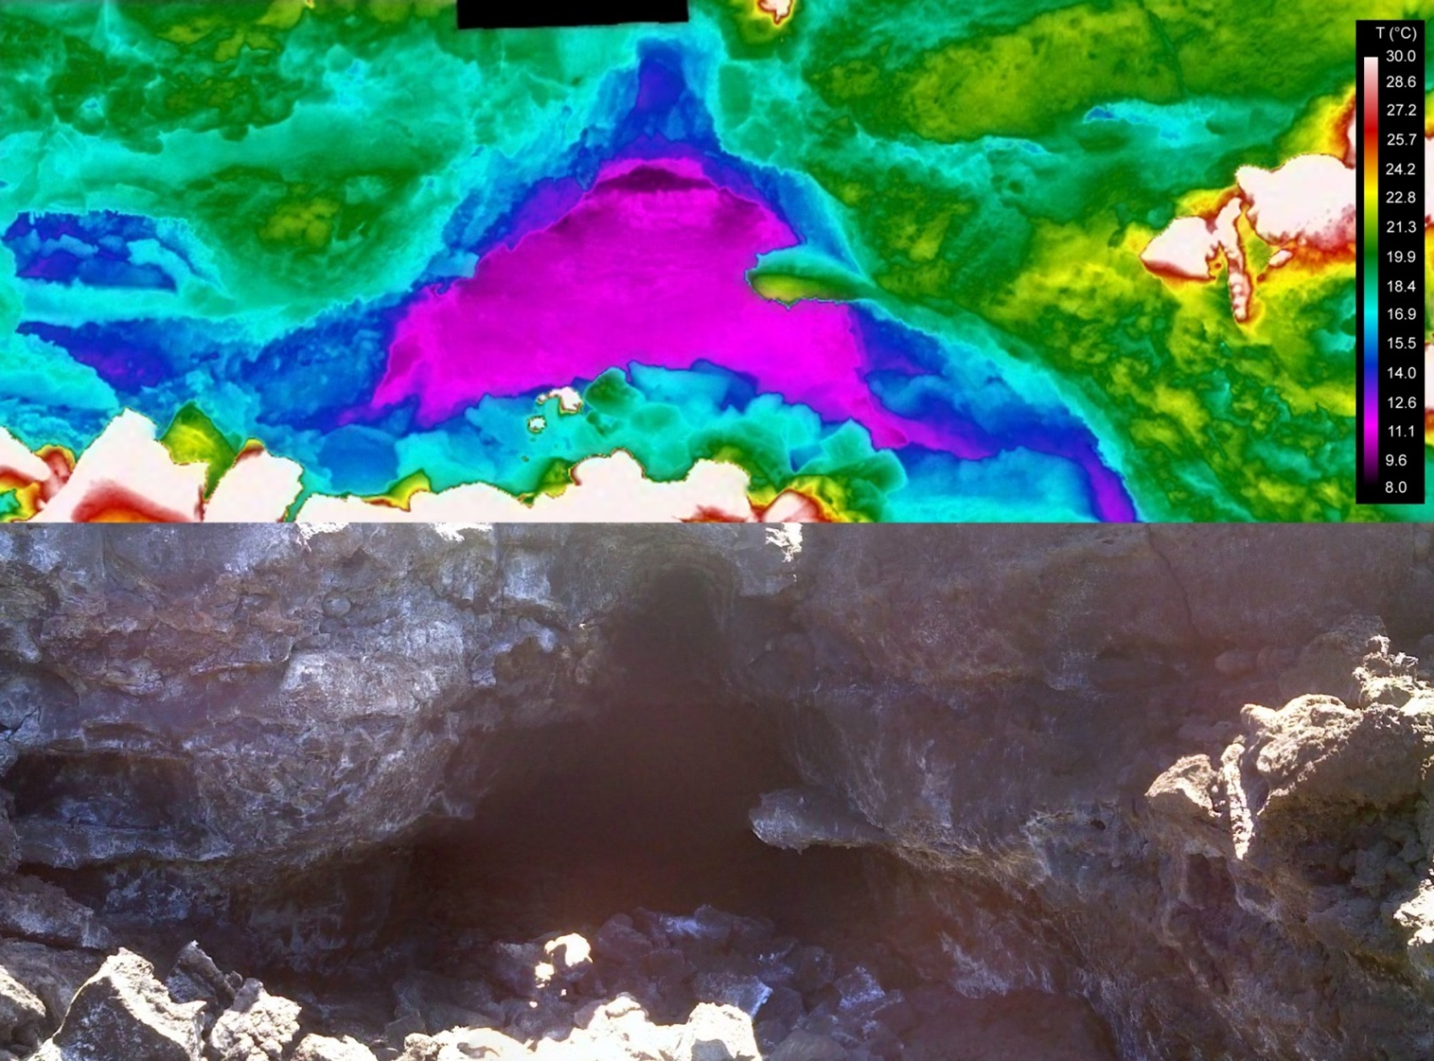
Lava tube entrance
Early afternoon temperature distribution, sunny day

Slide 23
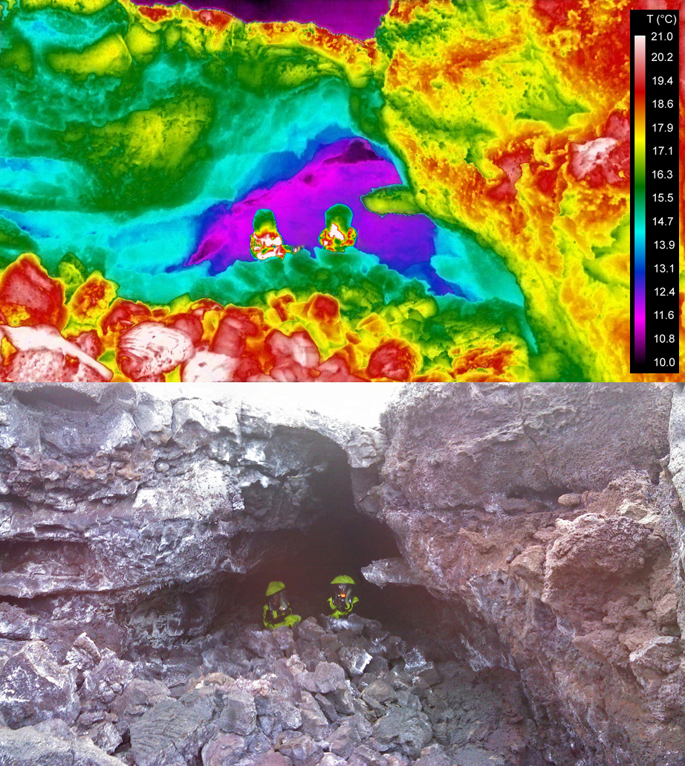
Lava tube entrance
Late afternoon temperature distribution, overcast day

Slide 24
Lava tube entrance
Late afternoon temperature distribution, overcast day

Slide 25
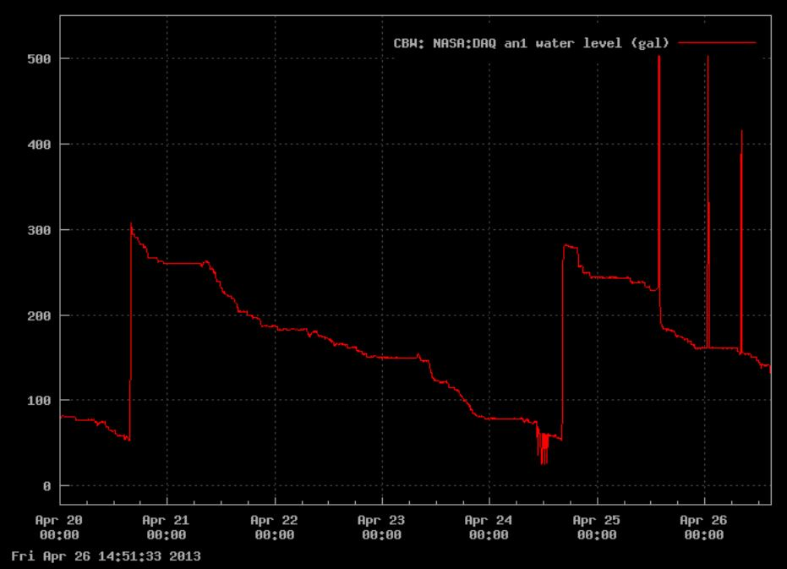
Habitat Rhythm: Daily Life Seen Through Sensor Analysis

Slide 26
Habitat Rhythm: Daily Life Seen Through Sensor Analysis
Wake
Sleep
Wake
Water Fill

Slide 27
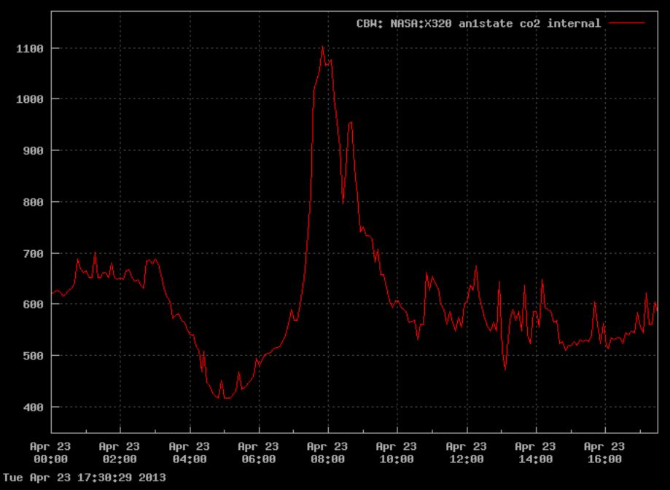
Crew Activities via CO2 Sensors

Slide 28
Crew Activities via CO2 Sensors
Morning Workouts
Breakfast
Wake
Sleep

Slide 29
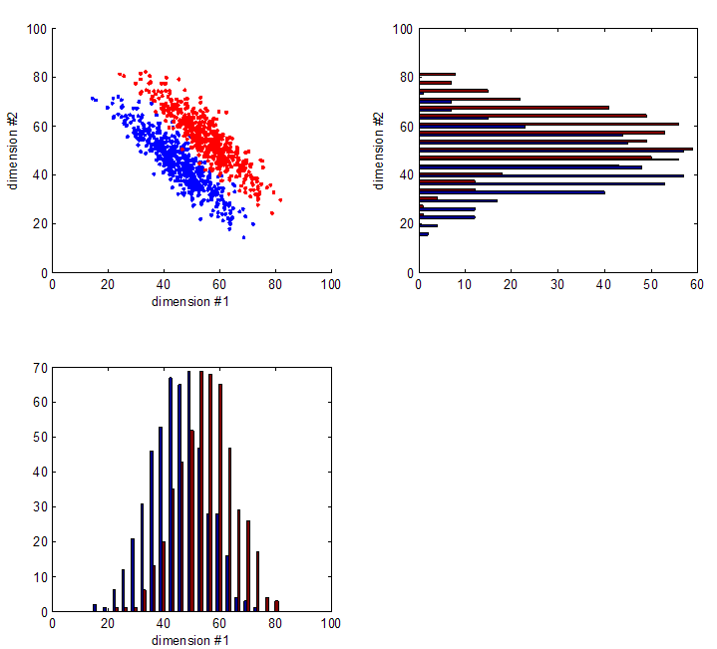
The Intelligent Habitat
Future planetary habitats monitored via centralized AI
Data Fusion Model will created to monitor systems
Daily sensor patterns to predict daily energy water needs
Crew interface activities with computer
Computer predict potential power/water issues then request actions via crew (Reduce water usages etc.)
Greater number of sensors to identify power/water usage in finer detail (washroom sink vs. shower or Kitchen sink)

Slide 30
Conclusion
This mission has provided the benchmark for Power and Water Consumption for small long term Planetary Missions

